Slide 1
Argentina
Argentina is a country located in South America, it has an estimate of 45,485, 166 people as of January 2020.
It has an area of 2780,400 km2 and it is the eighth-largest country in the world and fourth-largest in America.
It is also known to have the largest population speaking the Spanish language.
These features are so essential in understanding the geographical study of South America.

Slide 2
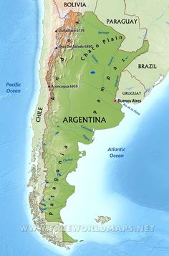
Physical Geography Map of Argentina
https://www.pinterest.com/pin/247838785729719243/

Slide 3
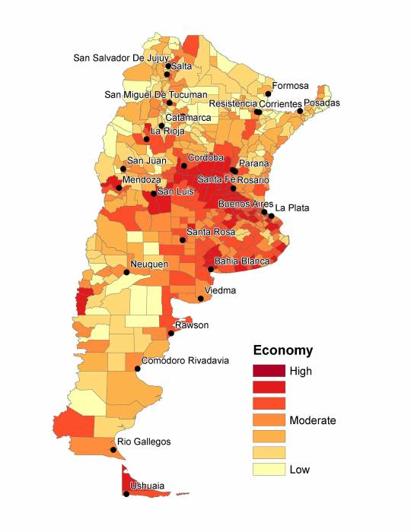
Population and Settlement map of Argentina
https://sara.openquake.org/_detail/social_vulnerability:argentina:4_argentina_economy.jpg?id=argentina

Slide 4
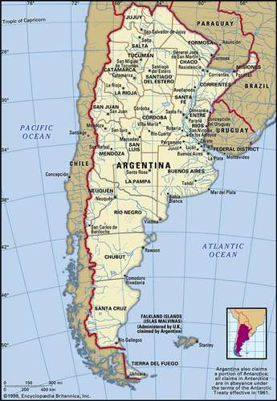
Cultural geography map of Argentina
https://www.britannica.com/place/Argentina

Slide 5
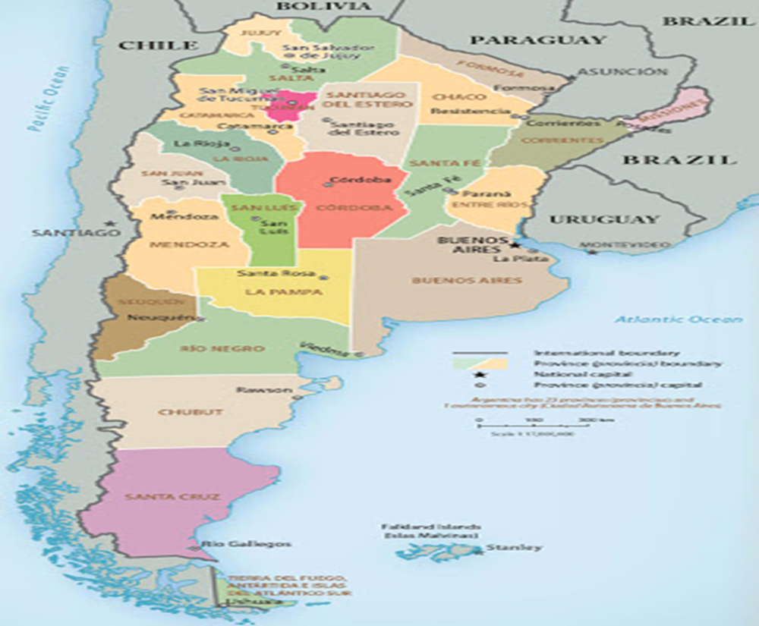
Geopolitics map of Argentina
http://www.geographicguide.net/america/argentina-political.htm

Slide 6
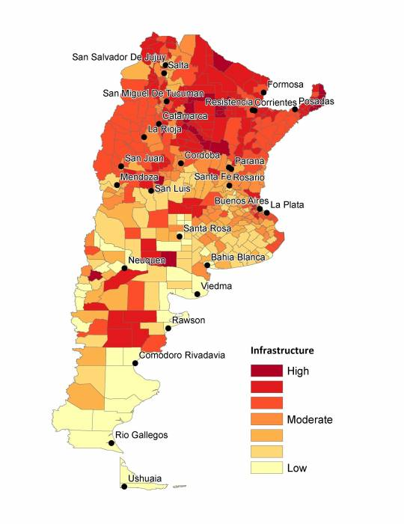
Economy map of Argentina
https://sara.openquake.org/_detail/social_vulnerability:argentina:2_argentina_infrastructure.jpg?id=argentina

